Slide 1
Welcome to
Class 3LN

Slide 2
3LN
Class Teacher
Miss Nason
Other adults
Miss Stylianou

Slide 3
Other teaching staff
Mrs Anne Gregoriou will take the children for ICT on Tuesday afternoons.
Miss Therese Conway will teach Music on Tuesday afternoons.

Slide 4
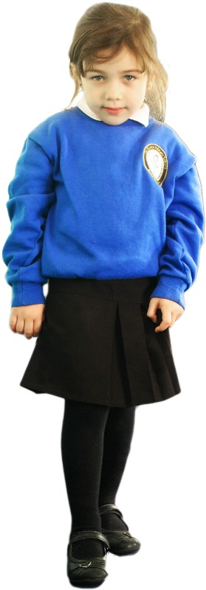
Girls
White Shirt
Royal Blue Cardigan/V neck jumper
Dark Grey/Black Skirt or Trousers
White/Grey/Black Tights or Socks
Black School Shoes

Slide 5
Boys
White Shirt
Royal Blue v neck jumper
Dark Grey/Black Trousers or Shorts
Black School Shoes

Slide 6
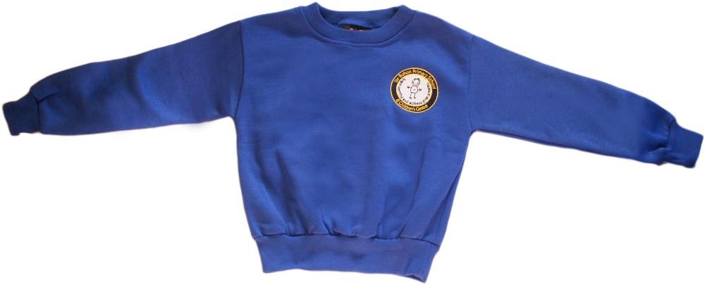
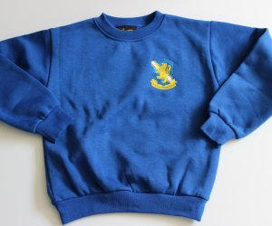
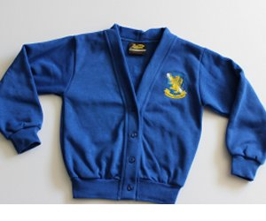
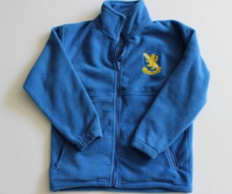
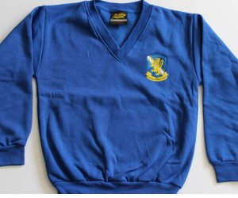
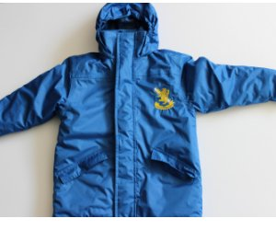
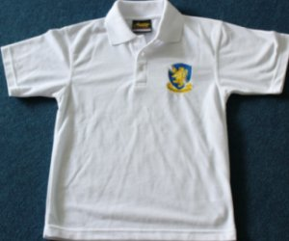
School Uniform
Sweatshirts, cardigans and fleeces, with the school logo, can be purchased
from https://www.smithsschoolwear.co.uk/store/

Slide 7
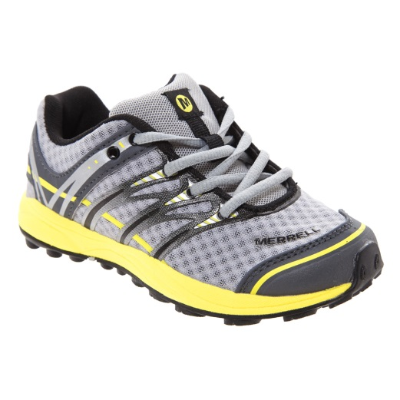
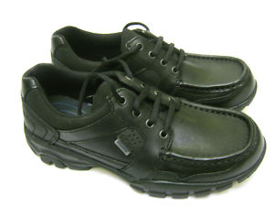
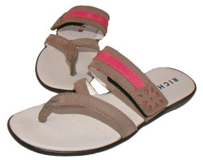
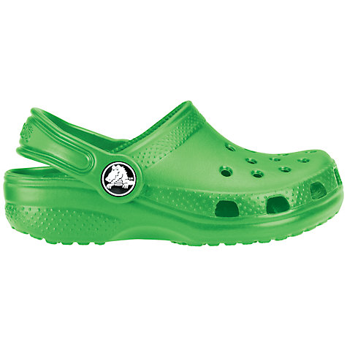
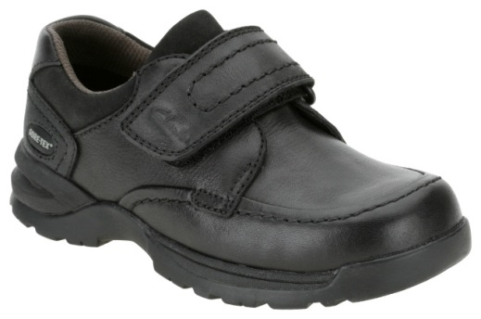
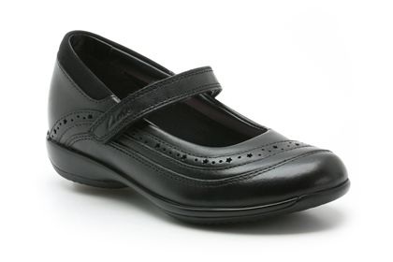
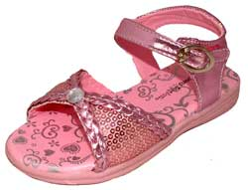
Before you buy school shoes, think about their suitability
x
x
x
x
x
✓
✓
x

Slide 8
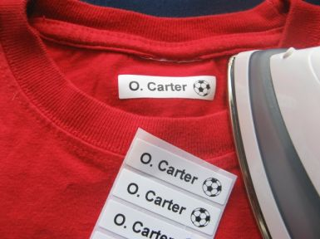
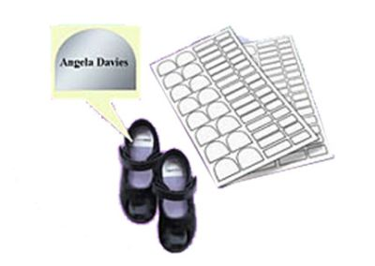
Don’t forget to label EVERYTHING!

Slide 9
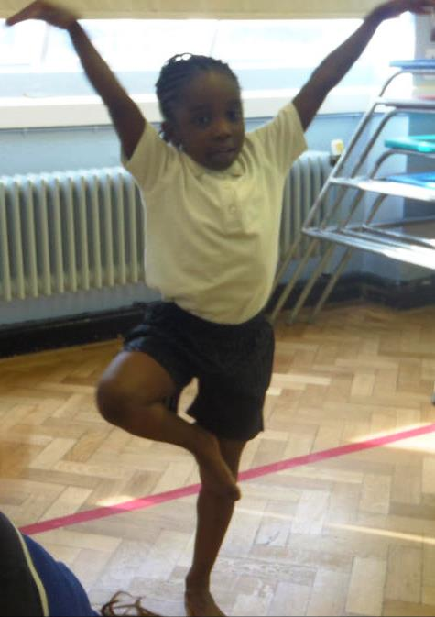
Year 3LN PE
Outdoor PE – Wednesday morning
Indoor PE – Thursday afternoon
PE kit should be left in school for the whole week.

Slide 10
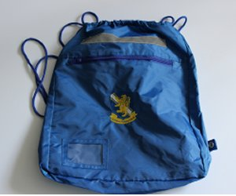
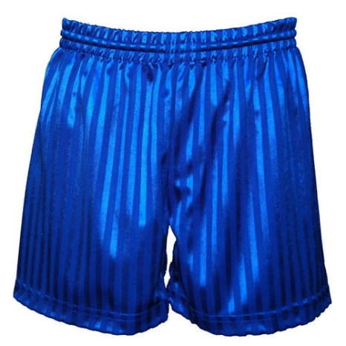
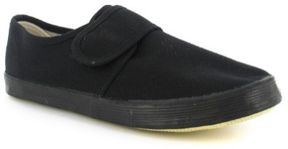
The PE kit is shorts and a t-shirt for indoor PE. For outdoor PE the P.E. kit is blue tracksuit/jogging bottoms, tracksuit top/sweatshirt, white T-shirt and trainers/plimsolls.
We encourage bare foot work for gymnastics for safety and high quality.
No jewellery is allowed for PE.
It is important every child takes part in PE and wears the appropriate kit. Please ensure your child has their PE kit in school on the relevant days.
£4.00 + VAT
£6.50

Slide 11
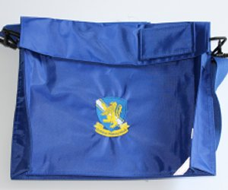
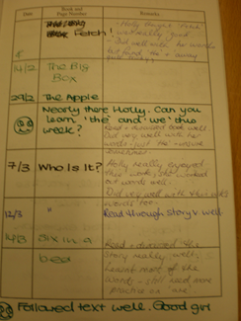
£4.40
+ VAT
Accelerated reading books
Books should be regularly changed and be in school daily.
Please make a comment in the reading diary and sign to say you have heard your child read.

Slide 12
Home/School
Liaison Book
Homework is sent home on Friday and should be completed at home and returned on Wednesday morning.
The children will have a online homework. Mymaths.com for maths and Spag.com for English. Children will also be sent spellings to learn at home for Fridays spelling test.
However the children love a project and may be set a challenge, design or investigation.
Year 3
Homework due in Wednesday
Name Harry Potter

Slide 13
Look | Say | Cover | Write | Check
Words | 1st try | 2nd try | 3rd try | 4th try
bank
think
honk
sunk
pink
Your child needs to be supervised while they are doing their homework and spellings.
In the homework folder there is place for you to make a comment about the work and for your child to do so too.

Slide 14
De Bohun Primary School
British Values Statement
At De Bohun Primary School we value the diversity of backgrounds of all pupils, families and wider school community.
The Department for Education states that there is a need:
“To create and enforce a clear and rigorous expectation on all schools to promote the fundamental British values of democracy, the rule of law, individual liberty and mutual respect and tolerance of those with different faiths and beliefs”.

Slide 15
Learning 2 Learn Skills
We want our children to become responsible citizens who care for their neighbours, community and the wider environment. It is most important that they understand how to look after themselves in this ever-changing world.
This year our celebration assemblies will be focussed on these themes:-
The ‘learning to learns’ skills are:
Relationships
Responsibility
Resilience
Resourceful
Risk-Taking
Reflective

Slide 16
WHY ATTENDANCE AT DE BOHUN SCHOOL IS SO IMPORTANT
If a child of compulsory school age is registered at a school it is essential that they attend their school regularly and maintain a pattern of good attendance throughout their school career. Excellent attendance at school is important to allow a child or young person to fulﬁl their potential.

Slide 17
Below are just some of the key reasons why it is so important children attend school:
To learn.
To have fun.
To make new friends.
To experience new things in life.
To develop awareness of other cultures, religion, ethnicity and gender differences.
To achieve.
To gain qualiﬁcations.
To develop new skills.
To build conﬁdence and self-esteem.
To have the best possible start in life.

Slide 18
EVERY SCHOOL DAY COUNTS
Every single day a child is absent from school equates to a day of lost learning. Attendance percentages can be misleading.
100% Attendance
0 Days Missed Excellent
95% Attendance
9 Days of Absence 1 Week and 4 Days of Learning Missed Satisfactory
90% Attendance
19 Days of Absence 3 Weeks and 4 Days of Learning Missed Poor
85% Attendance
28 Days of Absence 5 Weeks and 3 Days of Learning Missed Very Poor
80% Attendance
38 Days of Absence 7 Weeks and 3 Days of Learning Missed Unacceptable
75% Attendance
46 Days of Absence 9 Weeks and 1 Day of Learning Missed Unacceptable
Miss school
Miss out

Slide 19
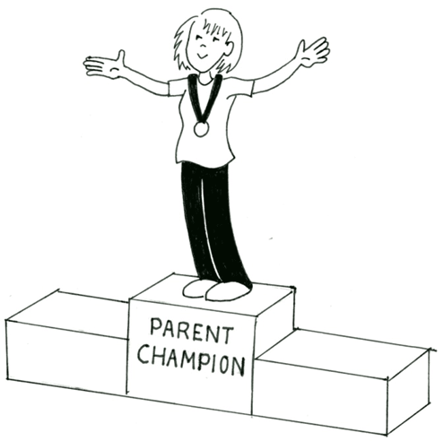
We are offering you the amazing opportunity to become 3LN’s Parent Champion!
You will be someone who will help us to build the school community as well as be a Champion for this class.
Responsibilities:
Organising the year group cake sale,
Supporting events such as discos, parties and the summer fair,
Organising and maintaining a class WhatsApp group to deliver class messages etc.
Organising parent reading volunteers,
Ask for feedback from the parents,
Liaise and feedback with/to the teacher,
During the term, the champion will have the opportunity to attend ‘Afternoon Tea’ with SLT, this will give you the opportunity to move the school forward by sharing ideas and feeding back any issues or ideas to the school.

