Slide 1
Welcome to
4SZ Class

Slide 2
4SZ
Class Teacher
Mrs Zaman
Floating Year 4 teacher
Miss Praill

Slide 3
Other teaching staff
Mrs Gregoriou will take the children for computing on Friday morning
Miss Conway will teach Music on Friday morning

Slide 4
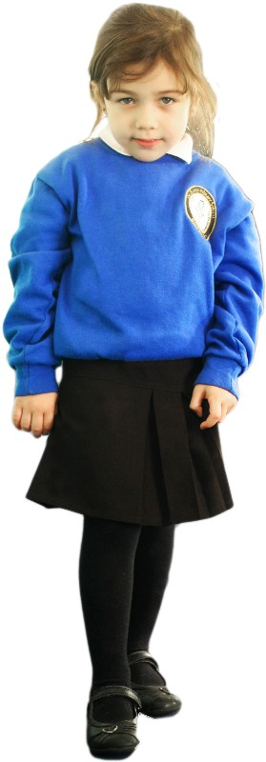
Girls
White Polo Shirt
Royal Blue Cardigan/Jumper
Dark Grey/Black Skirt or Trousers
White/Grey/Black Tights or Socks
Black School Shoes

Slide 5
Boys
White Polo Shirt
Royal Blue Jumper
Dark Grey/Black Trousers or Shorts
Black School Shoes

Slide 6
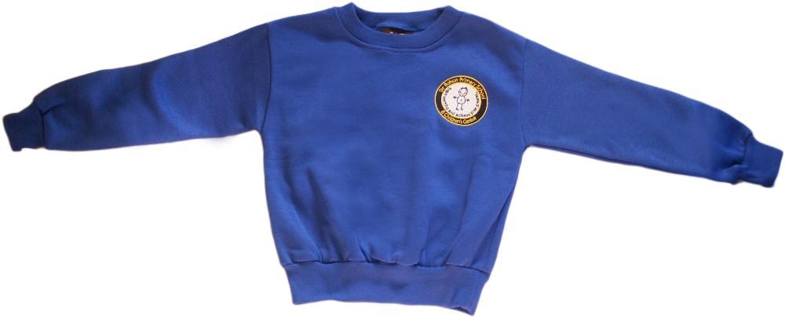
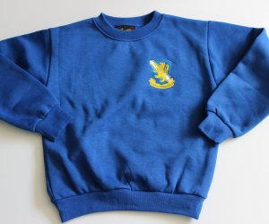
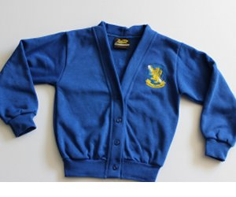
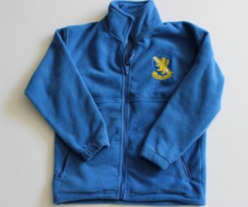
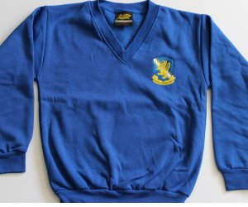
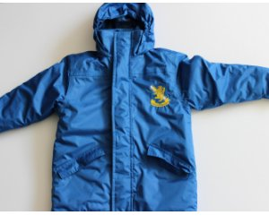
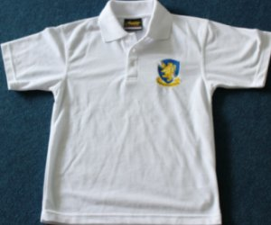
£12.50
£11
£12.00
£9.00
£12.00
£20.00
School Uniform
Sweatshirts, cardigans and fleeces, with the school logo, can be purchased
from http://www.brigade.uk.com/direct/index.php?pdPage=login

Slide 7
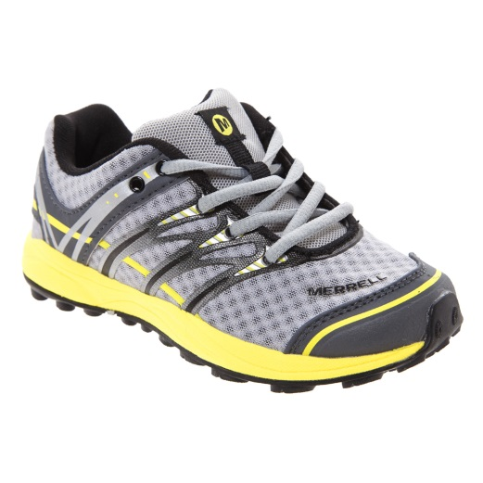
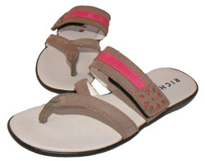
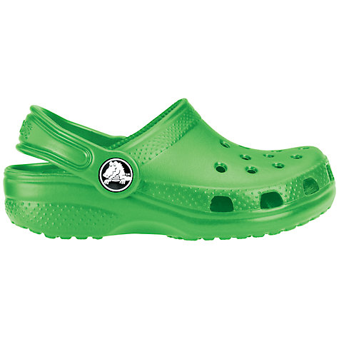
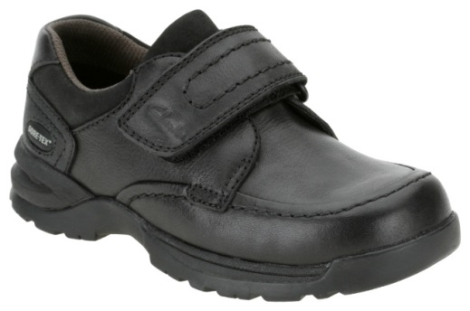
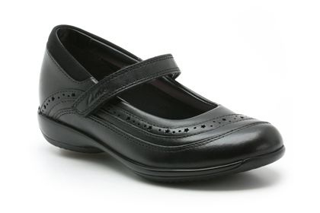
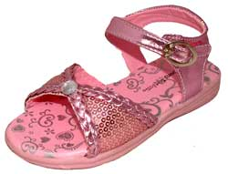
Before you buy school shoes, think about their suitability
x
x
x
x
✓
✓
x

Slide 8
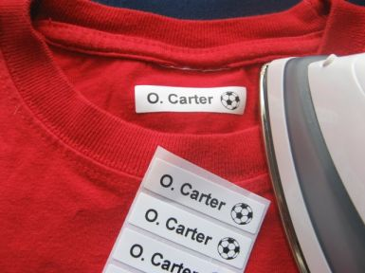
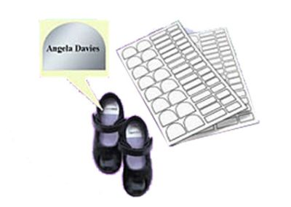
Don’t forget to label EVERYTHING!

Slide 9
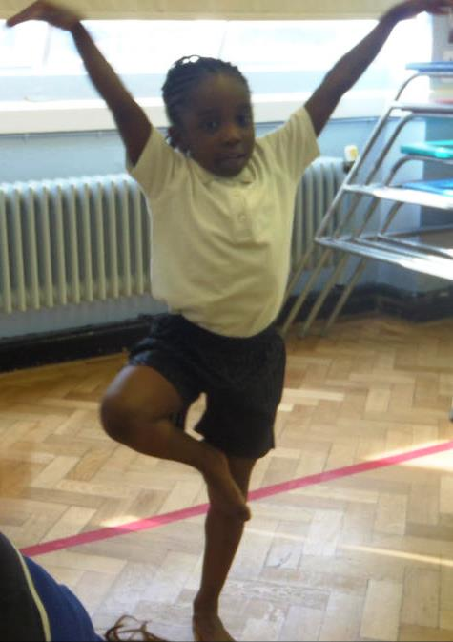
Year 4 PE
+
Outdoor PE session
Wednesday afternoon
Indoor PE session Thursday Morning
PE kit should be left in school for the whole week.

Slide 10
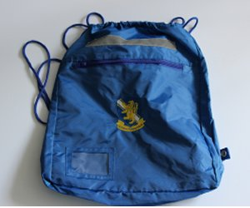
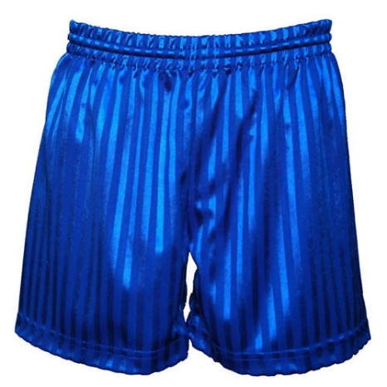
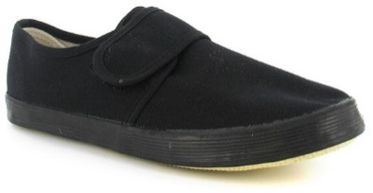
The PE kit is shorts and a t-shirt for indoor PE. For outdoor PE the P.E. kit is blue tracksuit/jogging bottoms, tracksuit top/sweatshirt, white T-shirt and trainers/plimsolls.
We encourage bare foot work for gymnastics for safety and high quality.
No jewellery is allowed for PE.
It is important every child takes part in PE and wears the appropriate kit. Please ensure your child has their PE kit in school on the relevant days.
£4.00 + VAT
£6.50

Slide 11
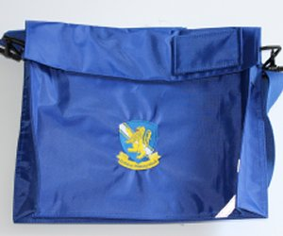
Accelerated Reading
Children are assessed on their reading.
They attend the library during the afternoon to select a book based on their age and ability.
Once they have read the book they return to the library and take a quiz to check their understanding.
Depending on their result, children will choose a new book or reread their current book.
£4.40
+ VAT
There is no limit on how many times a child can change their book.

Slide 12
Home/School
Liaison Book
Homework is sent out weekly and should be completed at home and returned on Tuesday.
The children will have a piece of literacy and Maths to do plus some spellings to learn which they will be tested on weekly .
Year 4
Homework due in Tuesday
Name

Slide 13
De Bohun Primary School
British Values Statement
At De Bohun Primary School we value the diversity of backgrounds of all pupils, families and wider school community.
The Department for Education states that there is a need:
“To create and enforce a clear and rigorous expectation on all schools to promote the fundamental British values of democracy, the rule of law, individual liberty and mutual respect and tolerance of those with different faiths and beliefs”.

Slide 14
Learning 2 Learn Skills
We want our children to become responsible citizens who care for their neighbours, community and the wider environment. It is most important that they understand how to look after themselves in this ever-changing world.
The ‘learning to learns’ skills are:
Relationships
Responsibility
Resilience
Resourceful
Risk-Taking
Reflective

Slide 15
WHY ATTENDANCE AT DE BOHUN SCHOOL IS SO IMPORTANT
If a child of compulsory school age is registered at a school it is essential that they attend their school regularly and maintain a pattern of good attendance throughout their school career. Excellent attendance at school is important to allow a child or young person to fulﬁl their potential.

Slide 16
Below are just some of the key reasons why it is so important children attend school:
To learn.
To have fun.
To make new friends.
To experience new things in life.
To develop awareness of other cultures, religion, ethnicity and gender differences.
To achieve.
To gain qualiﬁcations.
To develop new skills.
To build conﬁdence and self-esteem.
To have the best possible start in life.

Slide 17
EVERY SCHOOL DAY COUNTS
Every single day a child is absent from school equates to a day of lost learning. Attendance percentages can be misleading.
100% Attendance
0 Days Missed Excellent
95% Attendance
9 Days of Absence 1 Week and 4 Days of Learning Missed Satisfactory
90% Attendance
19 Days of Absence 3 Weeks and 4 Days of Learning Missed Poor
85% Attendance
28 Days of Absence 5 Weeks and 3 Days of Learning Missed Very Poor
80% Attendance
38 Days of Absence 7 Weeks and 3 Days of Learning Missed Unacceptable
75% Attendance
46 Days of Absence 9 Weeks and 1 Day of Learning Missed Unacceptable
Miss school
Miss out

Slide 18
We are offering you the amazing opportunity to become 4SZ’s Parent Champion!
You will be someone who will help us to build the school community as well as be a Champion for this class.
Responsibilities:
Organising the year group cake sale,
Supporting events such as discos, parties and the summer fair,
Organising and maintaining a class WhatsApp group to deliver class messages etc,
Organising parent reading volunteers,
Ask for feedback from the parents,
Liaise and feedback with/to the teacher,
During the term, the champion will have the opportunity to attend ‘Afternoon Tea’ with SLT, this will give you the opportunity to move the school forward by sharing ideas and feeding back any issues or ideas to the school.

Slide 19
Celebrating Our Differences Day

