Slide 1
Welcome to
5ZA Class

Slide 2
Year 5 team
Ms Edwards, Miss Ali and Mr Constantinides
5ZA Class Teacher
Miss Ali

Slide 3
Other teaching staff
Mrs Anne Gregoriou will take the children for ICT on Friday afternoon.
Miss Therese Conway will teach Music on Friday afternoon.
Mr Constantinides will be a regular support within the year 5 classes.

Slide 4
UNIFORM
Girls
White Shirt
Royal Blue Cardigan/V neck jumper
Dark Grey/Black Skirt or Trousers
White/Grey/Black Tights or Socks
Black School Shoes
Boys
White Shirt
Royal Blue v neck jumper
Dark Grey/Black Trousers or Shorts
Black School Shoes

Slide 5
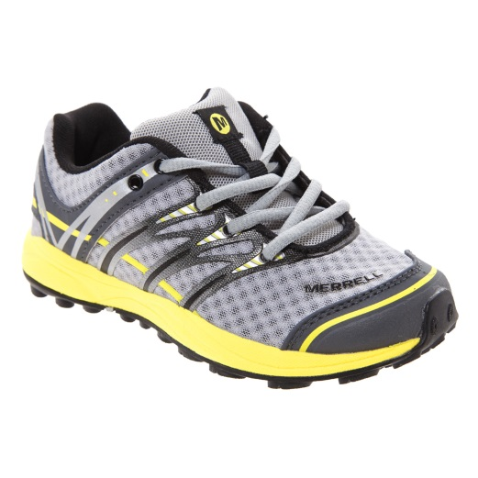
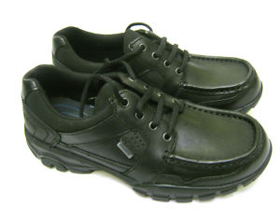
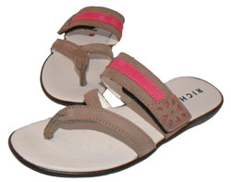
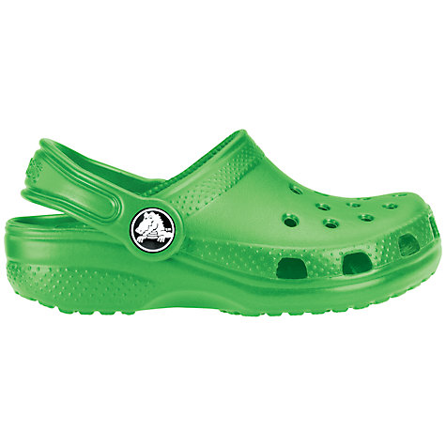
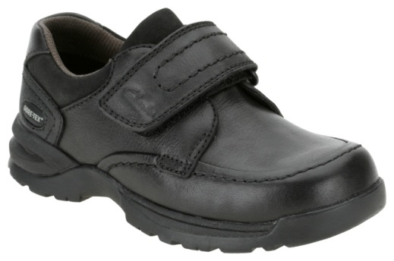
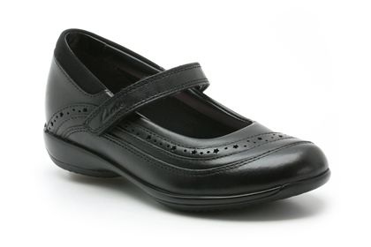
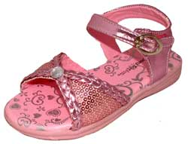
Before you buy school shoes, think about their suitability
x
x
x
x
x
✓
✓
x

Slide 6
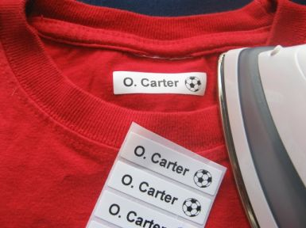
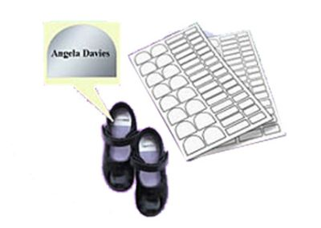
Don’t forget to label EVERYTHING!

Slide 7
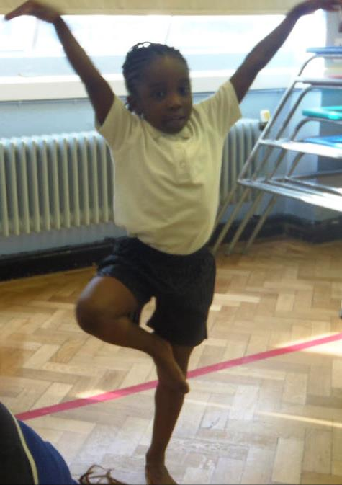
Year 5ZA PE
Outdoor PE – Tuesday afternoon
Indoor PE – Wednesday morning
PE kit should be left in school for the whole week.

Slide 8
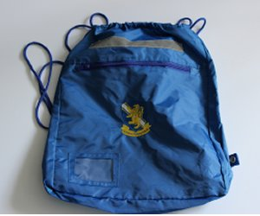
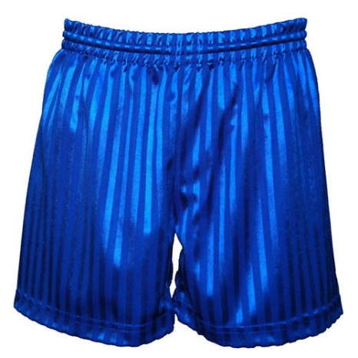
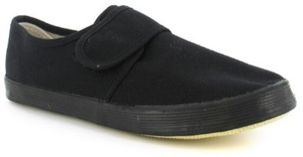
The PE kit is shorts and a t-shirt for indoor PE. For outdoor PE the P.E. kit is blue tracksuit/jogging bottoms, tracksuit top/sweatshirt, white T-shirt and trainers/plimsolls.
We encourage bare foot work for gymnastics for safety and high quality.
No jewellery or wrirst bands are allowed for PE.
It is important every child takes part in PE and wears the appropriate kit. Please ensure your child has their PE kit in school on the relevant days.

Slide 9
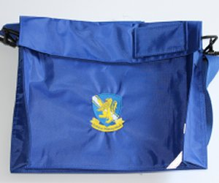
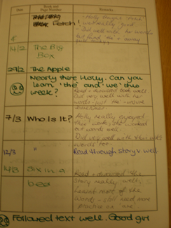
Accelerated reading books
Books should be regularly changed and be in school daily.
Please make a comment in the reading diary and sign to say you have heard your child read.

Slide 10
Home/School
Liaison Book
Homework is set on line on Thursday and should be completed at home and returned on Wednesday morning.
However the children love a project and may set a challenge, design or investigate.
Year 5
Homework due in Wednesday
Name Harry Potter

Slide 11
Look | Say | Cover | Write | Check
Words | 1st try | 2nd try | 3rd try | 4th try
accelerate
impeccable
desiccated
accept
Your child may need to be supervised while they are doing their homework and spellings.
However, they should be independent but you can test them and check for quality of presentation.
Also, ask them to teach you how to do what they have learnt today.
In the homework folder there is place for you to make a comment about the work and for your child to do so too.
Alternatively, catch the teacher on the play ground at the end of the day.

Slide 12
De Bohun Primary School
British Values Statement
At De Bohun Primary School we value the diversity of backgrounds of all pupils, families and wider school community.
The Department for Education states that there is a need:
“To create and enforce a clear and rigorous expectation on all schools to promote the fundamental British values of democracy, the rule of law, individual liberty and mutual respect and tolerance of those with different faiths and beliefs”.

Slide 13
EVERY SCHOOL DAY COUNTS
Every single day a child is absent from school equates to a day of lost learning. Attendance percentages can be misleading.
100% Attendance
0 Days Missed Excellent
95% Attendance
9 Days of Absence 1 Week and 4 Days of Learning Missed Satisfactory
90% Attendance
19 Days of Absence 3 Weeks and 4 Days of Learning Missed Poor
85% Attendance
28 Days of Absence 5 Weeks and 3 Days of Learning Missed Very Poor
80% Attendance
38 Days of Absence 7 Weeks and 3 Days of Learning Missed Unacceptable
75% Attendance
46 Days of Absence 9 Weeks and 1 Day of Learning Missed Unacceptable
Miss school
Miss out

Slide 14
Swimming will start in the Spring Term.
Be Prepared!
Try and make sure they have experienced going to a public swimming pool.
When they start lessons, practise in between lessons.
Have the right kit

Slide 15
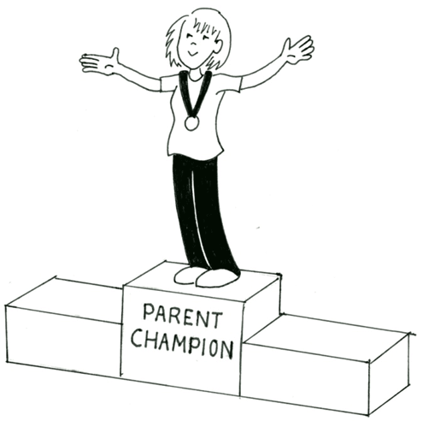
We are offering you the amazing opportunity to become 5ZA’s Parent Champion!
You will be someone who will help us to build the school community as well as be a Champion for this class.
Responsibilities:
Organising the year group cake sale,
Supporting events such as discos, parties and the summer fair,
Organising and maintaining a class WhatsApp group to deliver class messages etc,
Organising parent reading volunteers,
Ask for feedback from the parents,
Liaise and feedback with/to the teacher,
During the term, the champion will have the opportunity to attend ‘Afternoon Tea’ with SLT, this will give you the opportunity to move the school forward by sharing ideas and feeding back any issues or ideas to the school.

