Slide 1
Welcome to
Class 6HS

Slide 2
6HS
Class Teacher
Miss Smith
Support teachers
Mr Panchoo
Mrs Auvache
Mr Samura

Slide 3
Other teaching staff
Mrs Gregoriou will take the children for ICT on Thursday afternoons for one hour.
Miss Conway will teach Music on Thursday afternoons for one hour.
P.E. will take place on Monday and Wednesday afternoons.

Slide 4
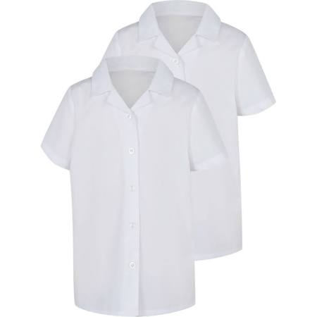
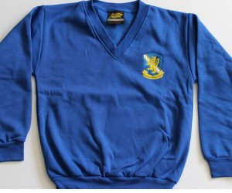
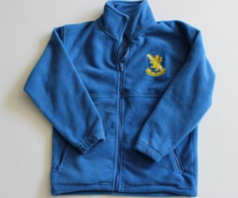
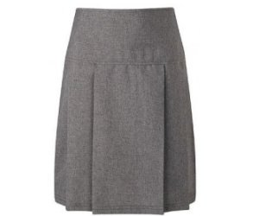
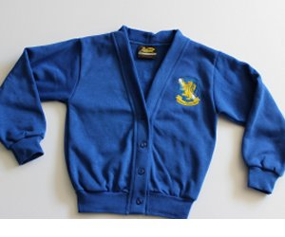
Girls
White Shirt
School tie
Royal Blue Cardigan/V neck jumper
Dark Grey/Black Skirt or Trousers
White/Grey/Black Tights or Socks
Black School Shoes

Slide 5
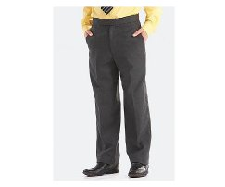
Boys
White Shirt
School tie
Royal Blue v neck jumper
Dark Grey/Black Trousers or Shorts
Black School Shoes

Slide 6
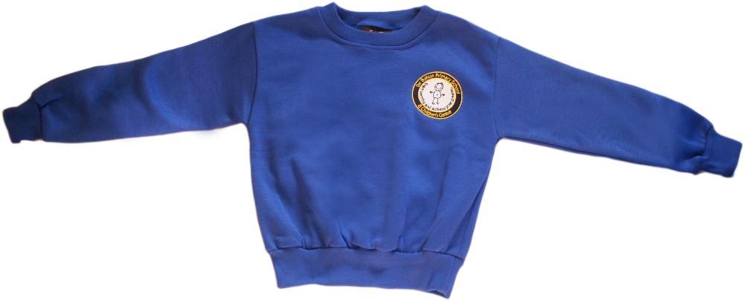
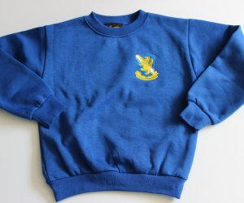
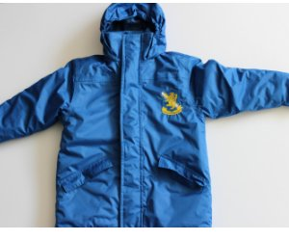
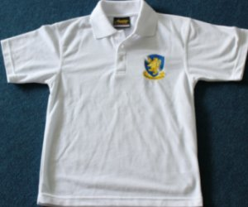
School Uniform
Sweatshirts, cardigans and fleeces, with the school logo, can be purchased
from https://www.smithsschoolwear.co.uk/store/

Slide 7
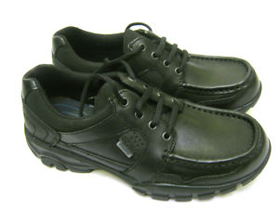
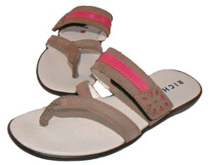
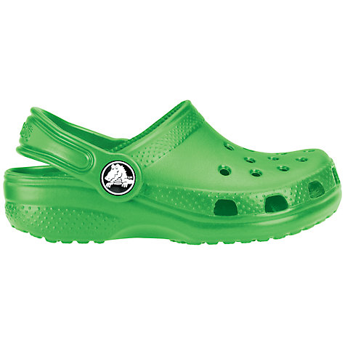
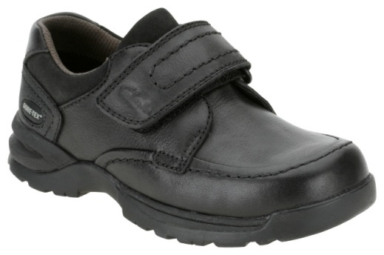
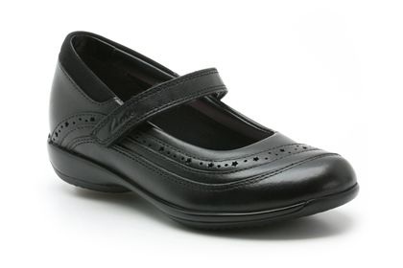
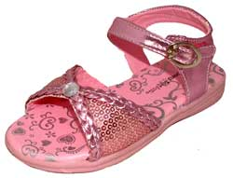
Before you buy school shoes, think about their suitability
x
x
x
x
x
✓
✓
x

Slide 8
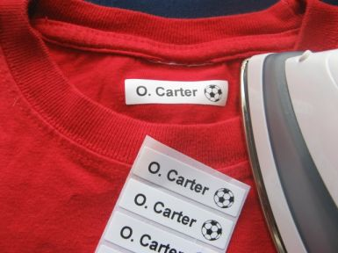
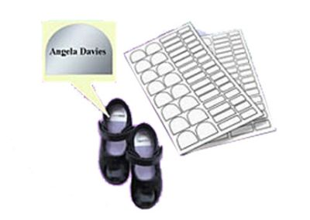
Don’t forget to label EVERYTHING!

Slide 9
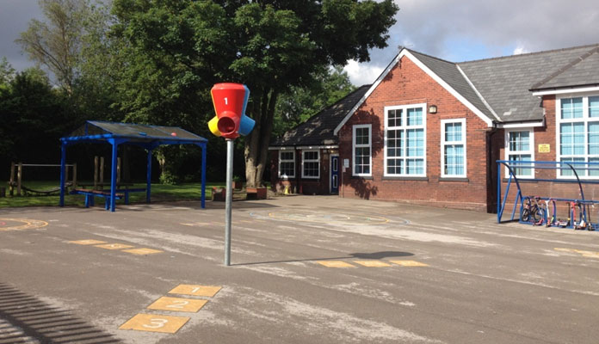
Outdoor PE – Monday Afternoon
Winter
tracksuit/jogging bottoms
tracksuit top/sweatshirt
Summer
T-shirt
Shorts
Always
Trainers / plimsolls

Slide 10
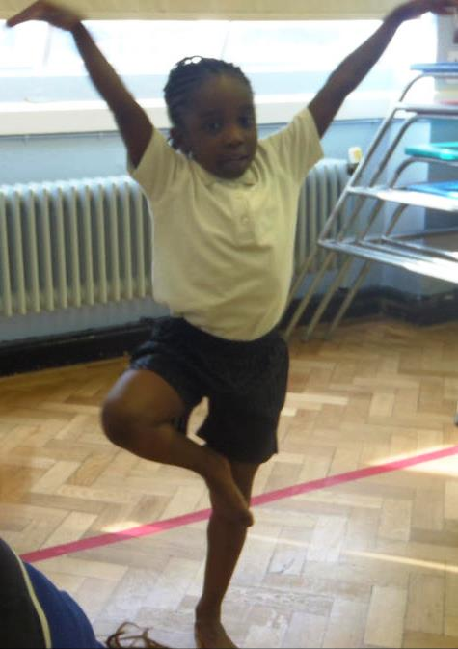
Year 6 PE
Indoor PE – Wednesday afternoons
Shorts
T-Shirt
We encourage bare foot work for gymnastics for safety and high quality.

Slide 11
Homework is sent home on Fridays and should be completed at home or at Homework Club (every morning). It should be returned on Wednesday morning.
The children will have a piece of English and Maths to do plus some spellings to learn which they will be tested on weekly.
Maths homework website:
https://www.mymaths.co.uk/
English/grammar homework website:
https://www.spag.com/
Home/School
Liaison Book
Year 6
Homework due in Wednesday
Name ……………

Slide 12
Look | Say | Cover | Write | Check
Words | 1st try | 2nd try | 3rd try | 4th try
bank
think
honk
sunk
pink
Your child needs to be supervised while they are doing their homework and spellings.
In the homework folder there is place for you to make a comment about the work and for your child to do so too.

Slide 13
SATs Week 13th – 16th May

Slide 14
3 maths papers
One arithmetic paper
2 reasoning papers
One grammar
One spelling
One reading

Slide 15
Ways to support your child
Children can attend the free morning homework club to practise times tables, grammar, reading, spelling and arithmetic.
It is very important that the children complete their homework so we can address any misconceptions in their understanding of a topic.
Reading for at least 20 minutes a day
Practising spellings and times tables

Slide 16
De Bohun Primary School
British Values Statement
At De Bohun Primary School we value the diversity of backgrounds of all pupils, families and wider school community.
The Department for Education states that there is a need:
“To create and enforce a clear and rigorous expectation on all schools to promote the fundamental British values of democracy, the rule of law, individual liberty and mutual respect and tolerance of those with different faiths and beliefs”.

Slide 17
Learning 2 Learn Skills
We want our children to become responsible citizens who care for their neighbours, community and the wider environment. It is most important that they understand how to look after themselves in this ever-changing world.
The ‘learning to learns’ skills are:
Relationships
Responsibility
Resilience
Resourceful
Risk-Taking
Reflective

Slide 18
WHY ATTENDANCE AT DE BOHUN SCHOOL IS SO IMPORTANT
If a child of compulsory school age is registered at a school it is essential that they attend their school regularly and maintain a pattern of good attendance throughout their school career. Excellent attendance at school is important to allow a child or young person to fulﬁl their potential.

Slide 19
Below are just some of the key reasons why it is so important children attend school:
To learn.
To have fun.
To make new friends.
To experience new things in life.
To develop awareness of other cultures, religion, ethnicity and gender differences.
To achieve.
To gain qualiﬁcations.
To develop new skills.
To build conﬁdence and self-esteem.
To have the best possible start in life.

Slide 20
EVERY SCHOOL DAY COUNTS
Every single day a child is absent from school equates to a day of lost learning. Attendance percentages can be misleading.
100% Attendance
0 Days Missed: Excellent
95% Attendance
9 Days of Absence 1 Week and 4 Days of Learning Missed: Satisfactory
90% Attendance
19 Days of Absence 3 Weeks and 4 Days of Learning Missed: Poor
85% Attendance
28 Days of Absence 5 Weeks and 3 Days of Learning Missed: Very Poor
80% Attendance
38 Days of Absence 7 Weeks and 3 Days of Learning Missed: Unacceptable
75% Attendance
46 Days of Absence 9 Weeks and 1 Day of Learning Missed: Unacceptable
Miss school
Miss out

Slide 21
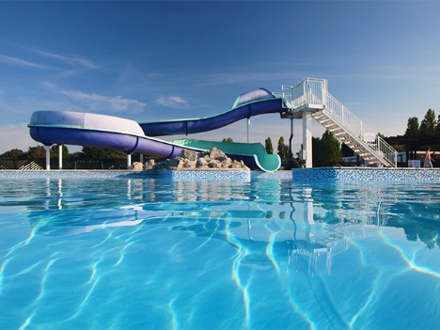
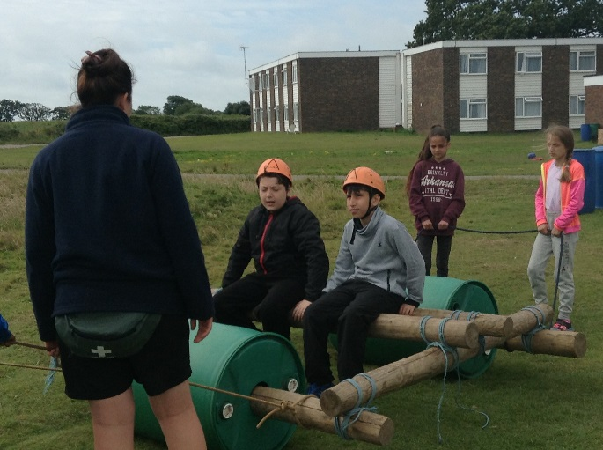
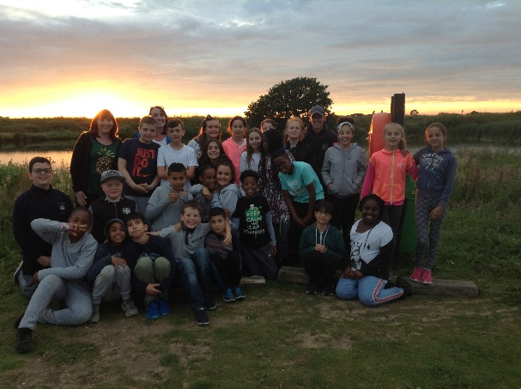
Year 6
School Journey 2018

Slide 22
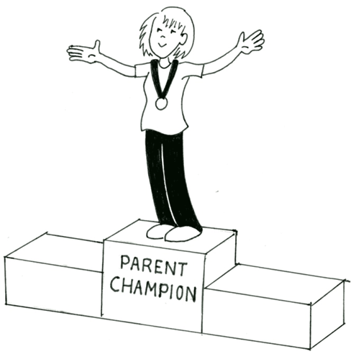
We are offering you the amazing opportunity to become 6JS’s
Parent Champion!
You will be someone who will help us to build the
school community as well as be a Champion for this class.
Responsibilities:
Organising the year group cake sale,
Supporting events such as discos, parties and the summer fair,
Organising and maintaining a class WhatsApp group to deliver class messages etc,
Organising parent reading volunteers,
Ask for feedback from the parents,
Liaise and feedback with/to the teacher,
During the term, the champion will have the opportunity to attend ‘Afternoon Tea’ with SLT, this will give you the opportunity to move the school forward by sharing ideas and feeding back any issues or ideas to the school.

Slide 23
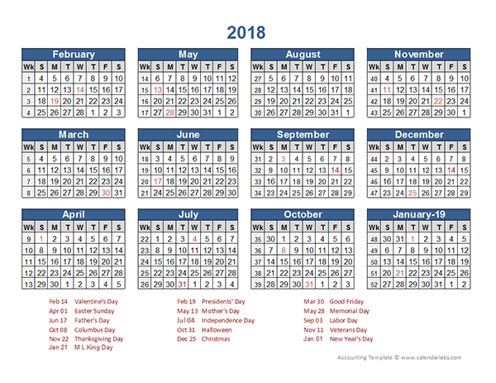
Key Dates This Term
6HS Class Assembly: Thursday 4th October at 9:00am
Secondary School application deadline – 31st October
Parent’s Evening: Monday 26th November and Wednesday 28th November

