Slide 1
Welcome to
Rainbow Class

Slide 2
Rainbow Class
Class Teacher
Mr Kai Harper
Teaching Assistant
Mrs Beth Pali
Ms Karen Marriott
Mr Samura
Mrs Karen Wilkinson

Slide 3
Joining Mainstream
Children are also taught by their mainstream teacher once a week when they integrate with their class for a session with support from Rainbow Class.
They also join their class for play times and lunch time in the playground.

Slide 4
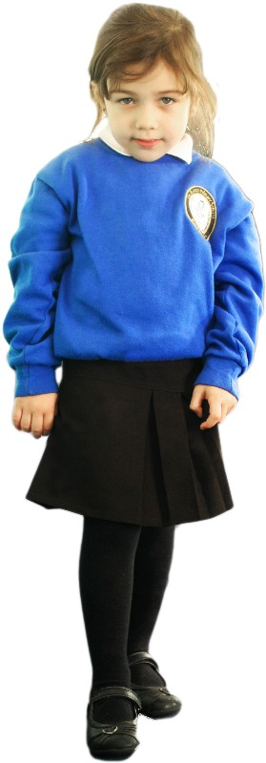
Girls
White Shirt
School tie
Royal Blue Cardigan/V neck jumper
Dark Grey/Black Skirt or Trousers
White/Grey/Black Tights or Socks
Black School Shoes

Slide 5
Boys
White Shirt
School tie
Royal Blue v neck jumper
Dark Grey/Black Trousers or Shorts
Black School Shoes

Slide 6
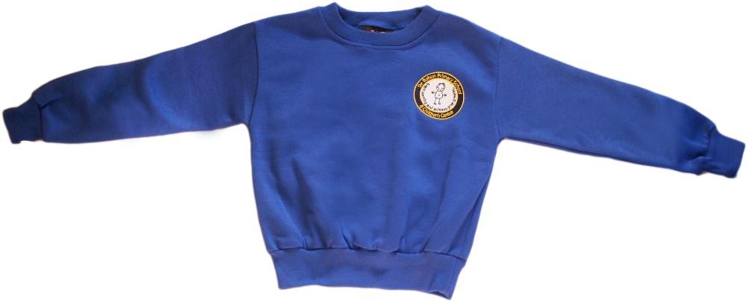
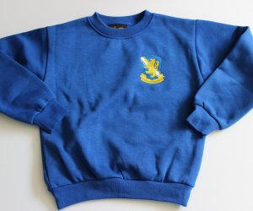
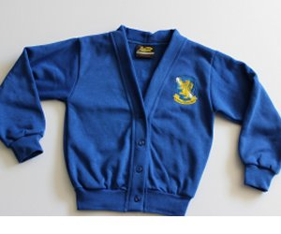
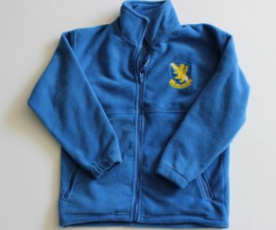
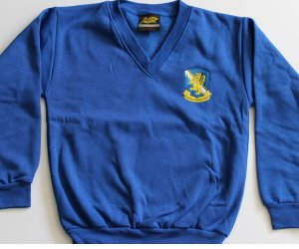
School Uniform
Sweatshirts, cardigans and fleeces, with the school logo, can be purchased
from https://www.smithsschoolwear.co.uk/store/

Slide 7
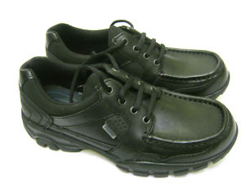
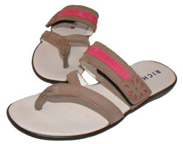
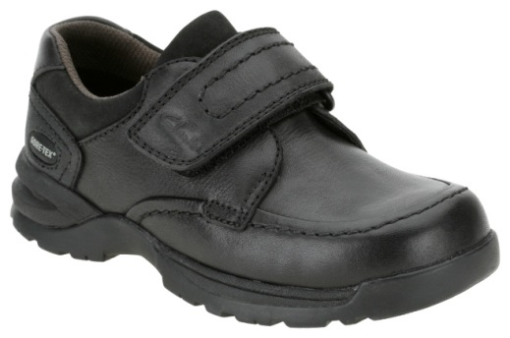
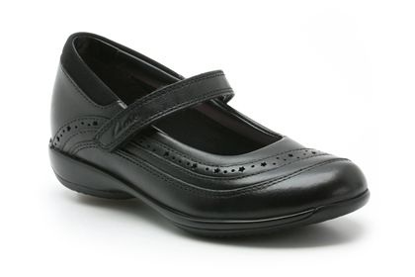
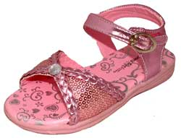
Before you buy school shoes, think about their suitability
x
x
x
x
x
✓
✓
x

Slide 8
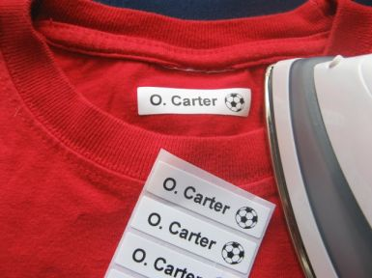
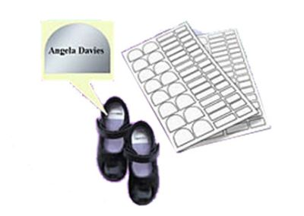
Don’t forget to label EVERYTHING!

Slide 9
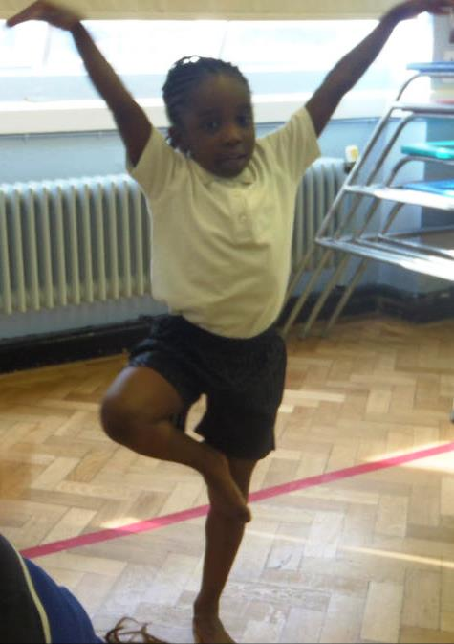
Rainbow PE
Outdoor PE – Friday Mornings
PE kit should be left in school for the whole week.

Slide 10
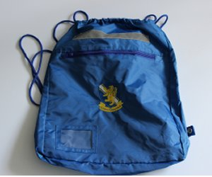
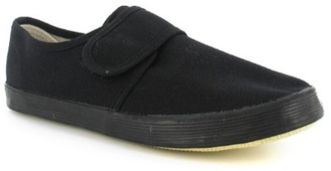
The PE kit is shorts and a t-shirt for indoor PE. For outdoor PE the P.E. kit is blue tracksuit/jogging bottoms, tracksuit top/sweatshirt, white T-shirt and trainers/plimsolls.
We encourage bare foot work for gymnastics for safety and high quality.
No jewellery is allowed for PE.
It is important every child takes part in PE and wears the appropriate kit. Please ensure your child has their PE kit in school on the relevant days.
£4.00 + VAT
£6.50

Slide 11
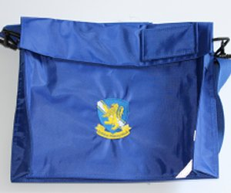
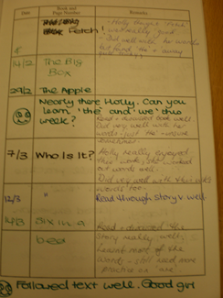
£4.40
+ VAT
Read Books
Reading books are changed on Thursdays. Book bags should be brought to school every day.
Please make a comment in the reading diary and sign to say you have heard your child read

Slide 12
Home/School
Liaison Book
We will begin to send homework home after the first week back.
This will be sent out on a Friday and needs to be returned by the following Friday. It will be either a piece of Maths or Literacy work and spellings.
Rainbow
Homework due in Friday
Name Harry Potter

Slide 13
Look | Say | Cover | Write | Check
Words | 1st try | 2nd try | 3rd try | 4th try
bank
think
honk
sunk
pink
Your child needs to be supervised while they are doing their homework and spellings.
In the homework folder there is place for you to make a comment about the work and for your child to do so too.

Slide 14
De Bohun Primary School
British Values Statement
At De Bohun Primary School we value the diversity of backgrounds of all pupils, families and wider school community.
The Department for Education states that there is a need:
“To create and enforce a clear and rigorous expectation on all schools to promote the fundamental British values of democracy, the rule of law, individual liberty and mutual respect and tolerance of those with different faiths and beliefs”.

Slide 15
Learning 2 Learn Skills
We want our children to become responsible citizens who care for their neighbours, community and the wider environment. It is most important that they understand how to look after themselves in this ever-changing world.
The ‘learning to learns’ skills are:
Relationships
Responsibility
Resilience
Resourceful
Risk-Taking
Reflective

Slide 16
WHY ATTENDANCE AT DE BOHUN SCHOOL IS SO IMPORTANT
If a child of compulsory school age is registered at a school it is essential that they attend their school regularly and maintain a pattern of good attendance throughout their school career. Excellent attendance at school is important to allow a child or young person to fulﬁl their potential.

Slide 17
Below are just some of the key reasons why it is so important children attend school:
To learn.
To have fun.
To make new friends.
To experience new things in life.
To develop awareness of other cultures, religion, ethnicity and gender differences.
To achieve.
To gain qualiﬁcations.
To develop new skills.
To build conﬁdence and self-esteem.
To have the best possible start in life.

Slide 18
EVERY SCHOOL DAY COUNTS
Every single day a child is absent from school equates to a day of lost learning. Attendance percentages can be misleading.
100% Attendance
0 Days Missed Excellent
95% Attendance
9 Days of Absence 1 Week and 4 Days of Learning Missed Satisfactory
90% Attendance
19 Days of Absence 3 Weeks and 4 Days of Learning Missed Poor
85% Attendance
28 Days of Absence 5 Weeks and 3 Days of Learning Missed Very Poor
80% Attendance
38 Days of Absence 7 Weeks and 3 Days of Learning Missed Unacceptable
75% Attendance
46 Days of Absence 9 Weeks and 1 Day of Learning Missed Unacceptable
Miss school
Miss out

