Slide 1
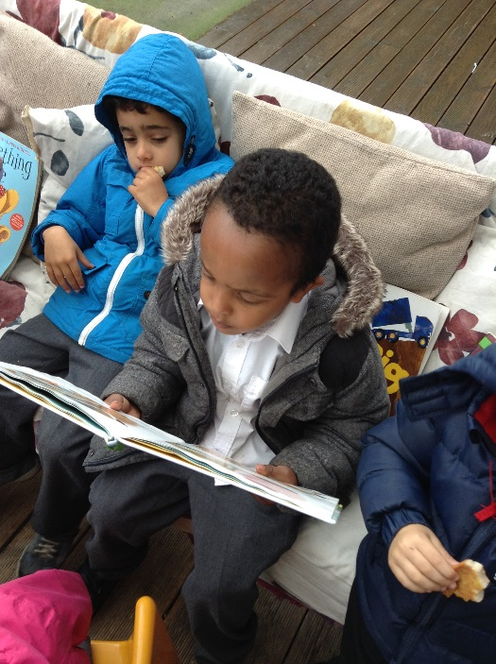
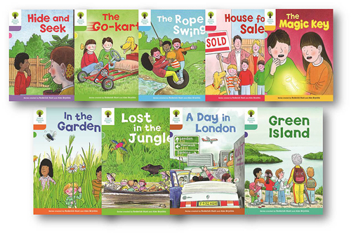
Phonics and Reading in Reception

Slide 2
Reading Early Learning Goal to be achieved by the end of Reception.
Children read and understand simple sentences.
They use phonic knowledge to decode regular words and read them aloud accurately.
They also read some common irregular words.
They demonstrate understanding when talking with others about what they have read.

Slide 3
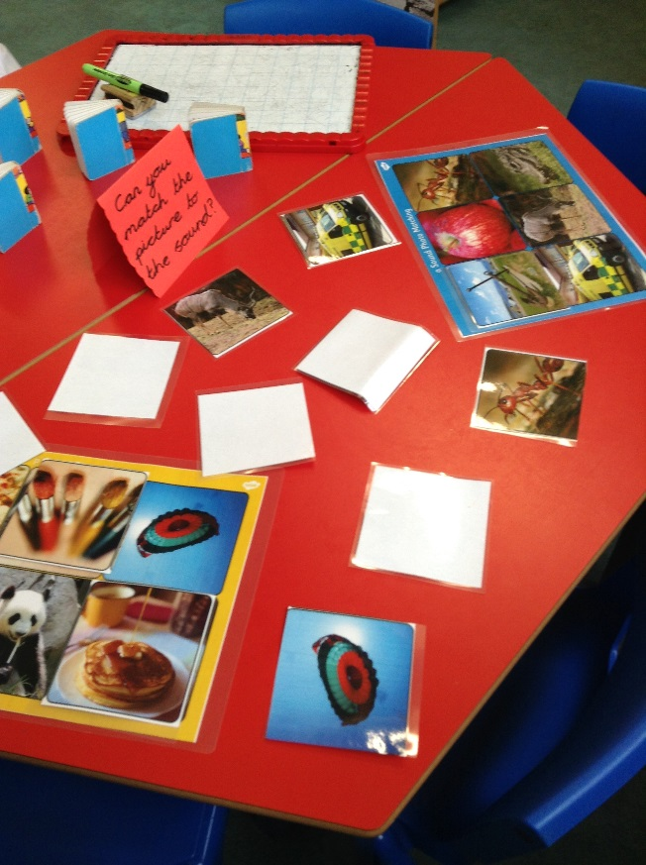
Expectations in Reading in Reception
Continues a rhyming string.
• Hears and says the initial sound in words.
• Can segment the sounds in simple words and blend them
together and knows which letters represent some of them.
• Links sounds to letters, naming and sounding the letters of
the alphabet.
• Begins to read words and simple sentences.
• Uses vocabulary and forms of speech that are increasingly
influenced by their experiences of books.
• Enjoys an increasing range of books.
• Knows that information can be retrieved from books and
computers.

Slide 4
Phonics
Phonics is taught on a daily basis for 20-30 minutes
A grapheme is a written symbol that represents a sound (phoneme). This can be a single letter, or could be a sequence of letters, such as ai, sh, igh, etc. So when a child says the sound /t/ this is a phoneme, but when they write the letter 't' this is a grapheme.
Children practise and revise ‘phonemes’ and ‘tricky words’ learnt previously
Children learn new phonemes and graphemes each day and begin to blend the sounds together to read words (Phase 2)
Children begin to learn CVC words such as ‘cat, pin, mog’.
Children read simple sentences with both decodable and tricky words with adult support where needed, for example,
‘The cat sat on the pot’.
Children learn new phonemes in Phase 3 most comprising of two letters, sh, ch, th, (diagraphs)
Children practise writing new graphemes and words. Children then write sentences using the new graphemes on whiteboards

Slide 5
Reading in Reception
Every day after lunch children read with their teacher in small groups
Children read a range of books matching their knowledge of phonics
Books are available for children to access throughout the day, each classroom has an inviting reading corner with a range of books and puppets. The outdoor area has a ‘reading den’ where children can share books and stories with one another in a cosy space.

Slide 6
Reading activities within the classroom
Each day the classrooms are set up to match the learning objectives in Maths and Literacy.
Independent reading activities are set up in all areas, these may include; sharing books in the book corner, matching sounds and pictures, finding hidden sounds and words around the environment, phonic puzzles and matching topic words to pictures.
Each week a planned ‘reading activity’ takes place led by the teacher when working with a small group of children.

Slide 7
Supporting your child at home using the Phonic Homework Pack
Practise phonemes (saying the sounds) on the alphabet mat with your child on a daily basis
Enjoy reading a range of books together and talking about the story/characters/settings and the beginning, middle and end of the story
Talk about the author and any other books they may have written.
Talk about the illustrator and the style of illustrations in the book
Read the book sent home from school daily and write any comments in the reading record for us to share
Complete the phonics homework pack on a daily/weekly basis

Slide 8
Weekly Phonics Homework Pack
Week 1 Homework
Using flashcards practice reading letters: s, a, t, p
Reading words and spelling words (ask children to try to read these then ask children to attempt to spell these on the back of this page):
sat cat mat pat tap
Tricky word to practice reading and spelling:
I …...... …...... …...... …...... …......
Sentence to read:
I sat on a mat

Slide 9
Reading books and records
Share your child’s reading book with them on a daily basis.
Please write into the reading log book so we know how you feel your child is doing with their reading. Do they need a more challenging book or is it too difficult?
Return the school reading book each Monday so we can issue your child with a new book
Go to the library to choose library books for your child based on their interests

Slide 10
How else can you support your child to read?
Make space
Have a special place or time when you read together without any distractions (turn the television, radio or computer off).
Make it fun!
Enjoy reading together. Give characters funny voices and engage in the pictures. Make a game out of finding words that rhyme or start with the same sound.
Be seen reading
Make sure your child sees you reading a range of reading materials; books, magazines, brochures…
Go online
Look online and in app stores for online reading stories, word and spelling games.
Use your local library
Go to your library regularly. Find the books that you loved to read as a child.

