Slide 1
Year 6 SATs
Parents Briefing
Friday 1st April 2022

Slide 2
Year 6 SATs are in the week beginning 9th May 2022.
No Year 6 absence during this week please.

Slide 3
KS2 SATs in 2022
In the summer term of 2022, children in Year 2 and Year 6 will be the fourth year who take the new SATs papers.
These tests in English and Maths reflect the new National Curriculum, and are more rigorous.

Slide 4
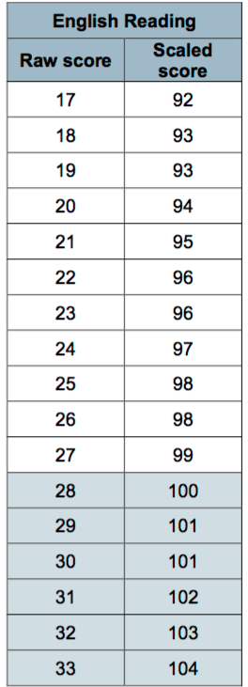
What is expected by the end of KS2?
You will be given your child’s raw score (the actual number of marks they get), alongside their scaled score and whether they have reached the national average.
The score needed to reach the national average is 100.

Slide 5
Ensuring the best results for your child – Parental support
Helping your child with their homework, hear them read and learn their multiplication tables and spellings.
Showing interest. Please ask your child how they are doing and about what they are learning in school.
Encourage your child to do their best in all of their homework and school work.
Ensure that your child has a good night’s sleep and encourage reading instead of computer games.

Slide 6
Test Timetable

Slide 7
Year 6 Reading

Slide 8
Key Stage 2 Reading
The reading test will provisionally be a single paper with questions based on one three separate texts. Your child will have one hour, including reading time, to complete the test.
There will be a selection of question types, including:
Summarising e.g. ‘Number the events below to show the order in which they happen in the story’
Labelling, e.g. ‘Label the text to show the title of the story’
Find and copy, e.g. ‘Find and copy one word that suggests what the weather is like in the story’
Short constructed response, e.g. ‘What does the bear eat?’
Open-ended response, e.g. ‘Look at the sentence that begins Once upon a time. How does the writer increase the tension throughout this paragraph? Explain fully, referring to the text in your answer.’

Slide 9
What’s tested?
2a | 2b | 2c | 2d
Give/explain the meaning of words in context. | Retrieve and record information / identify key details from fiction and non- fiction. | Summarise main ideas from more than one paragraph. | Make inferences from the text/ explain and justify inferences with evidence from the text.
2e | 2f | 2g | 2h
Predict what may happen from details stated and implied. | Identify/explain how information/ narrative content is related and contributes to meaning as a whole. | Identify/explain how meaning is enhanced through choice of words and phrases. | Make comparisons within the text.

Slide 16
Year 6 SPAG
What does ‘SPaG’ stand for?

Slide 17
KS2 SPAG
Part 1: Grammar and Punctuation (45 minutes)
This paper is made up of 50 ‘1mark’ answers
1. Selected response: this means that pupils will need to select the correct answer from a range of options.
2. Constructed response: this means that pupils will need to make changes or insert their own answers.

Slide 18
What’s tested?
Which sentence is written in standard English?
Identify the adverb in the sentence below.
Underline the main clause in this sentence.
Insert punctuation to correct the passage below.
Tick the sentence that
must end with a
question mark.
What does ‘misread’ mean? Tick the correct answer.
We was/were walking to school.

Slide 20
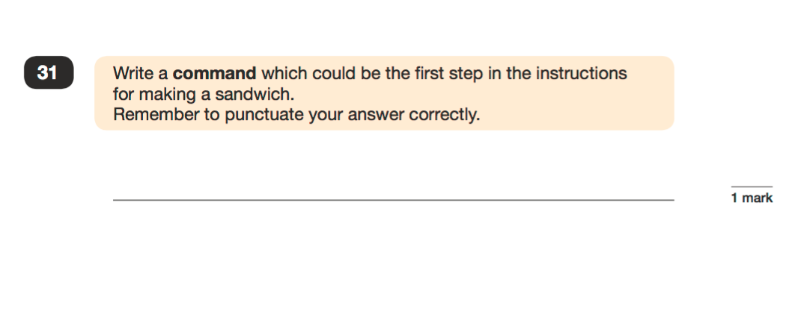
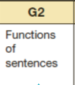
Wash your hands before you start cooking..

Slide 21
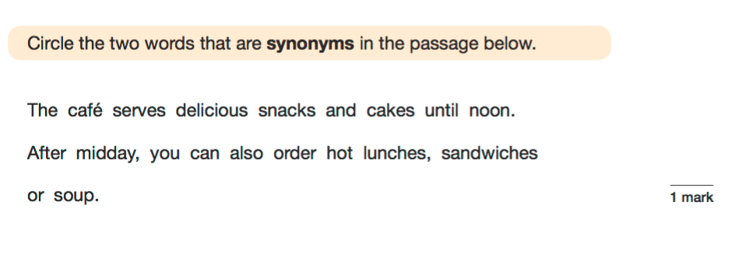

Slide 22
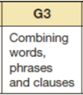
✓
✓
✓

Slide 23
KS2 SPAG
Part 2: Spellings (15 minutes)
20 spellings, including…
words from the year 3/4 curriculum
words from the year 5/6 curriculum
common suffixes (ible, ency, ous etc. )
silent letters (numb, crumb etc.)
Part 1 (50 marks) + Part 2 (20 marks) = 70 marks

Slide 24
Year 6 Maths

Slide 26
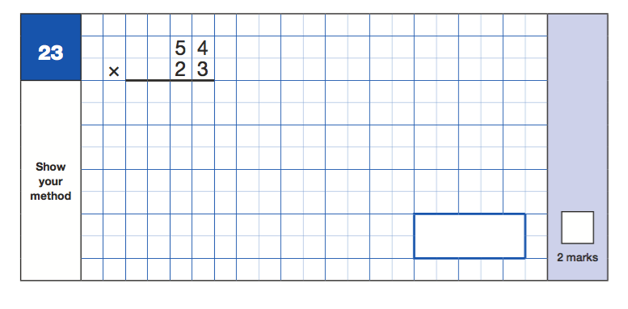
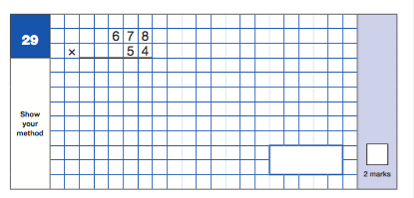

Slide 27
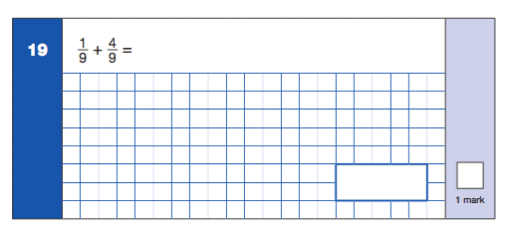
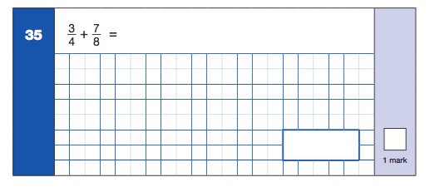

Slide 28
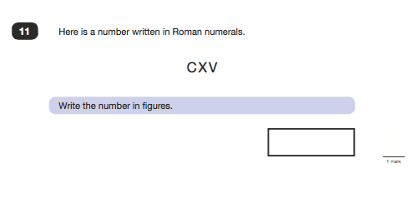
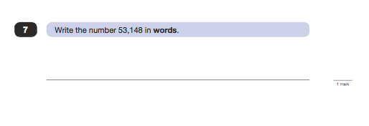

Slide 29
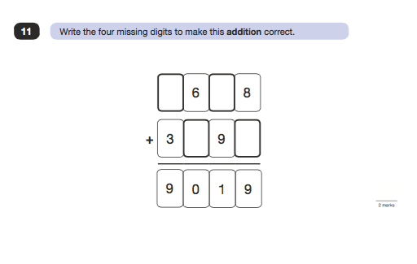

Slide 32
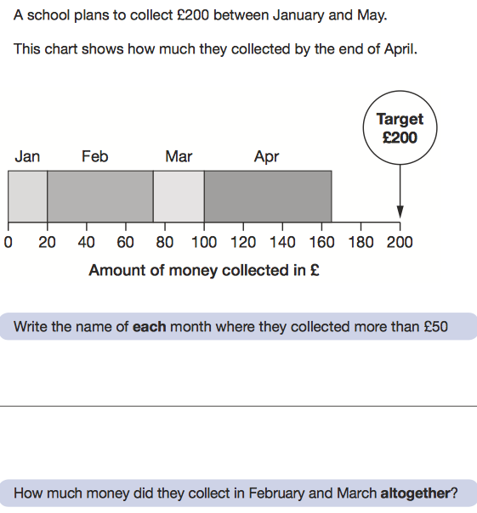

Slide 33
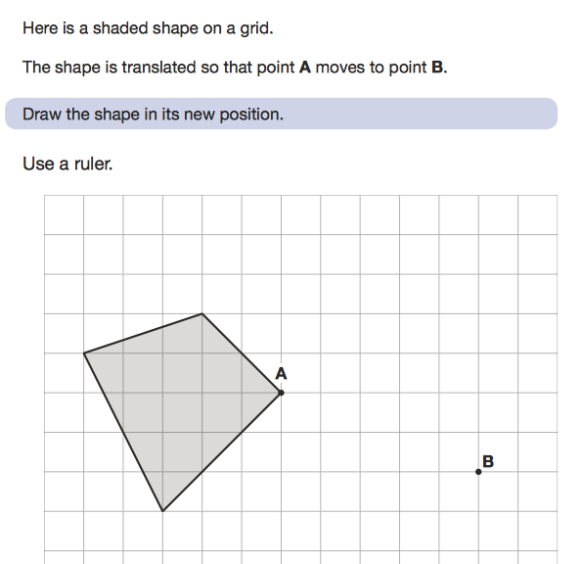

Slide 34
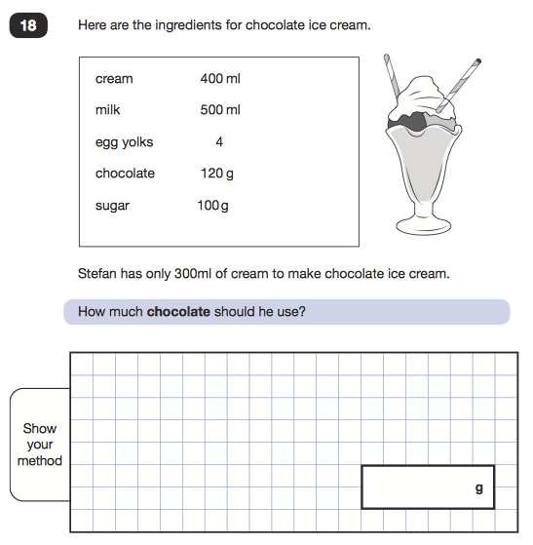

Slide 35
Any Questions?

